Slide 1
Microsoft Graph Overview
Microsoft Identity Platform
Developer Training
1

Slide 2





Microsoft 365
Identity
Productivity
Devices
Security
Microsoft Graph

Slide 3

Microsoft Graph
…is the Microsoft 365 data that describes the patterns of productivity, identity and security in an organization, accessed through a unified API endpoint.

Slide 4
Microsoft Graph powers our products

Slide 5
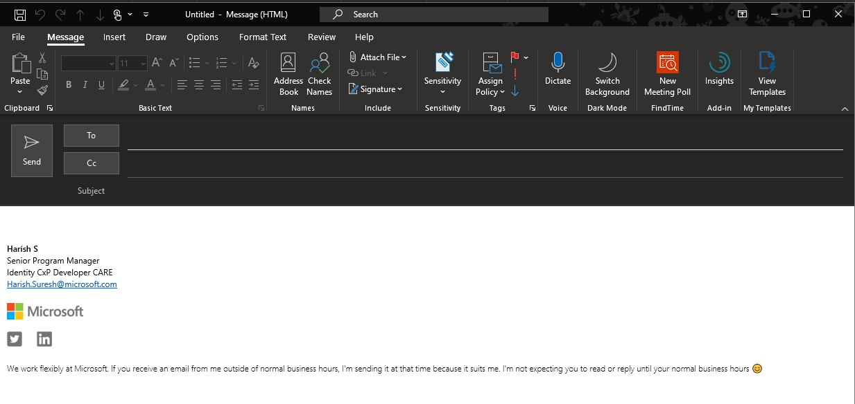
People

Slide 6
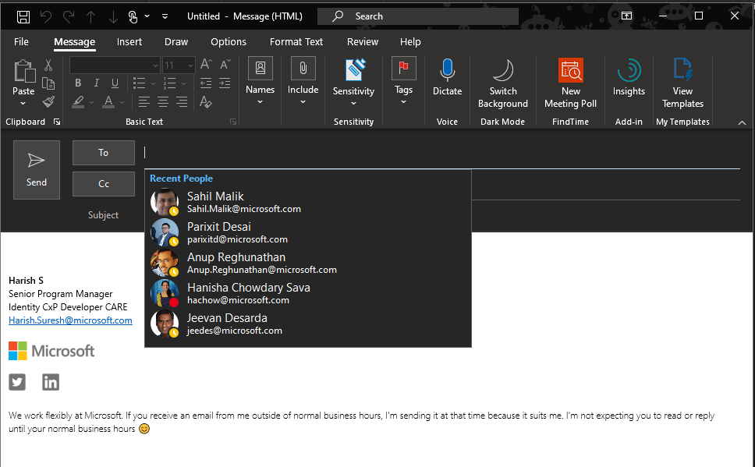



Recent People
Dana Wilkins (Syntex Corp)
v-danwil@contoso.com
Mat Anderson
matander@contoso.com
People
Jeremy Rosenfeld
jrose@contoso.com
SD
Sara Lopez
sarlopez@contoso
CG
Charmaine Graves (Syntex Corp)
v-chamgra@contoso

Slide 7
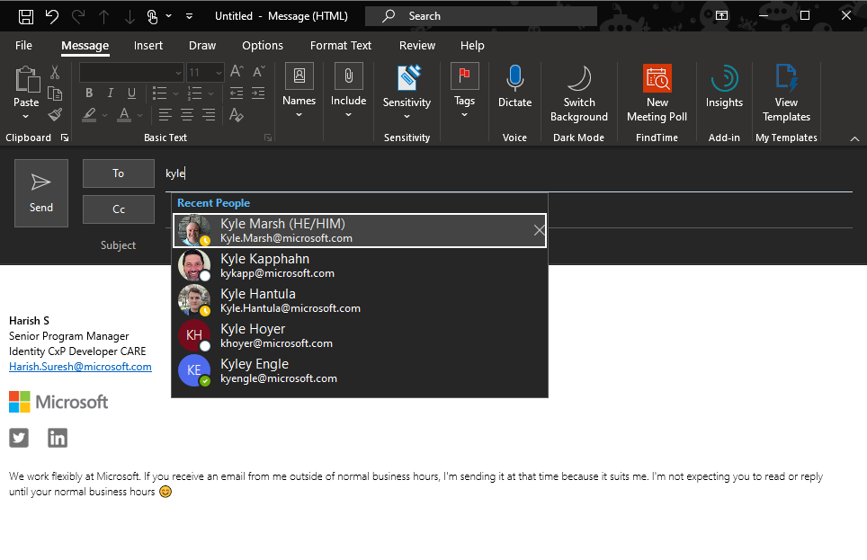
Jeremy
People

Slide 8
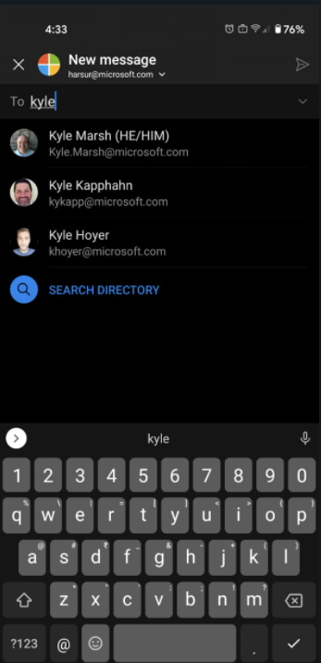



Jeremy
Recent People
Jeremy Rosenfeld
jrose@contoso.com
Jeremy Yi
jeremyi@contoso.com
People
Other Suggestions
Jeremy Champion (MECHANICS AND DEPLOYMENT)
Jchamp@contoso.com
JL
Jeremy LAGARDE
jlegarde@northwinds.com
Jeremy Kraft (OPERATIONS)
jeremyk@contoso.com

Slide 9
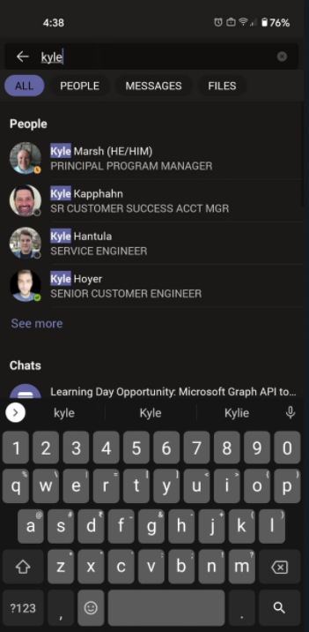
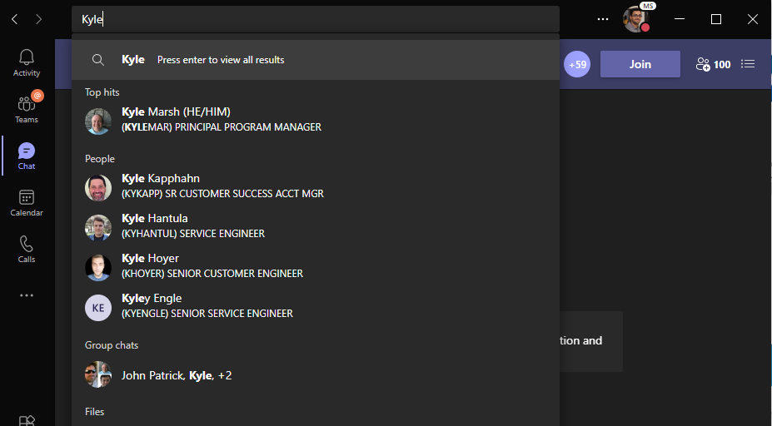
Mat Anderson
People
Jeremy Rosenfeld

Slide 10
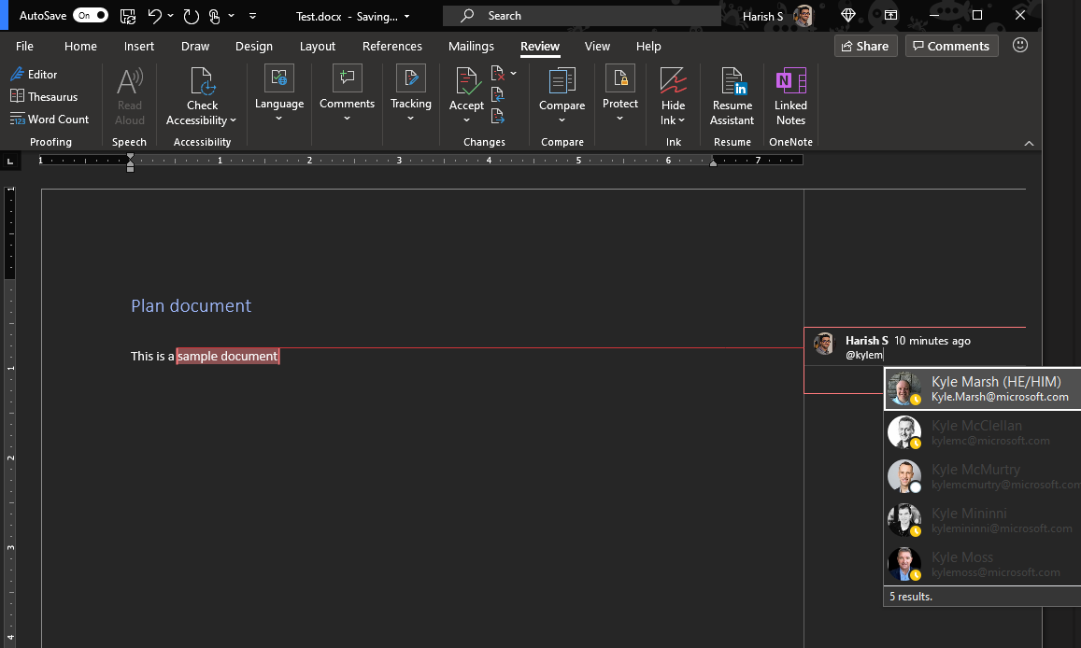
People

Slide 11
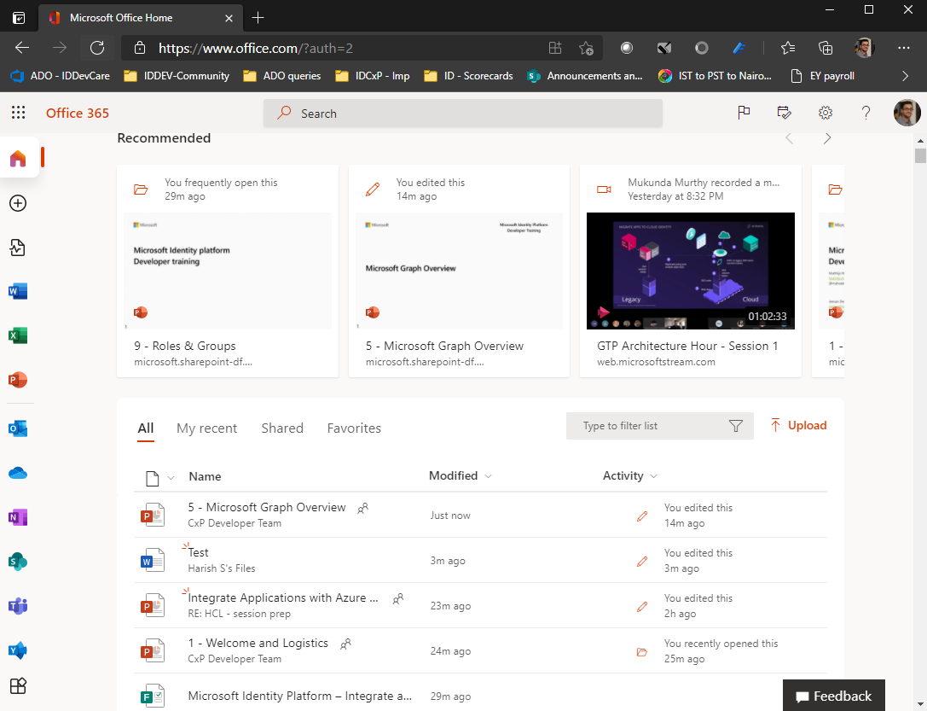
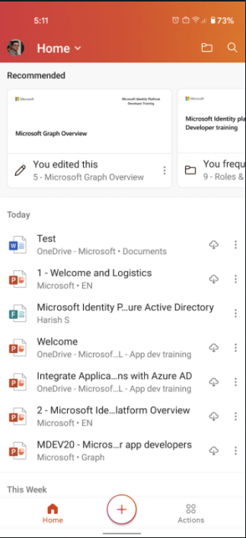
Files

Slide 12
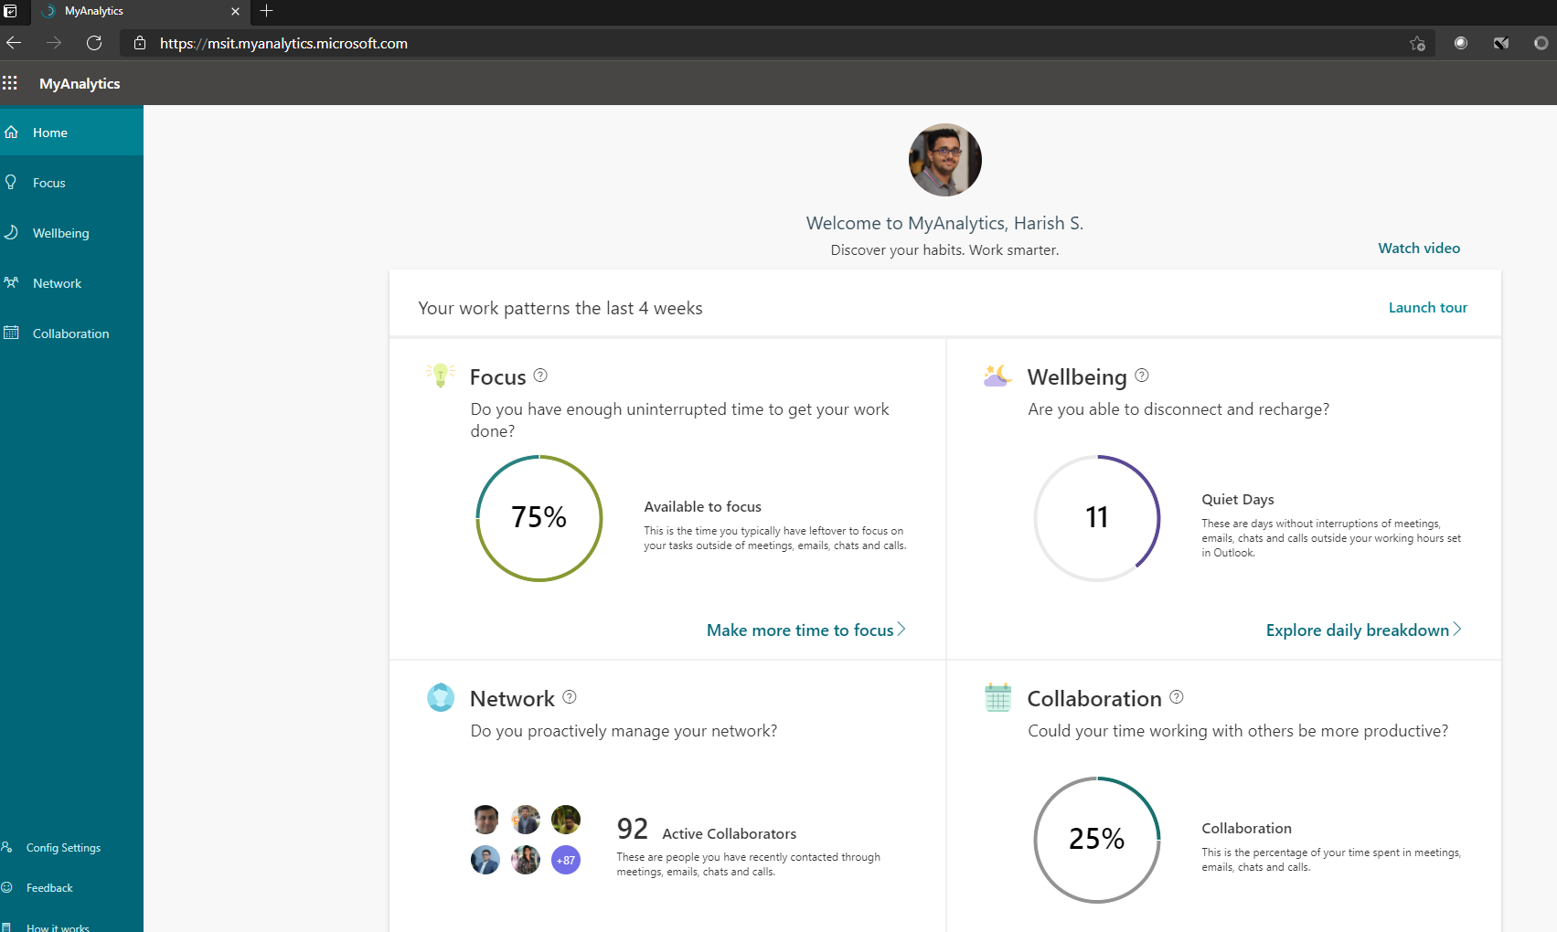
it.myanalytics.contoso.com
Analytics

Slide 13
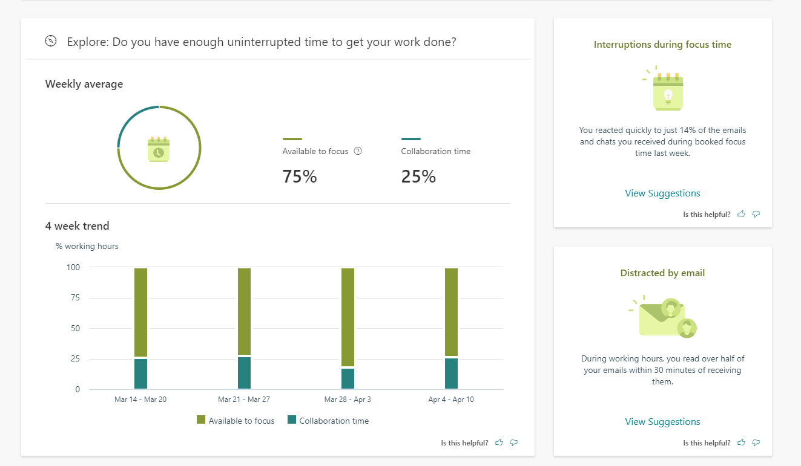
it.myanalytics.contoso.com/?v=focus
Analytics

Slide 14
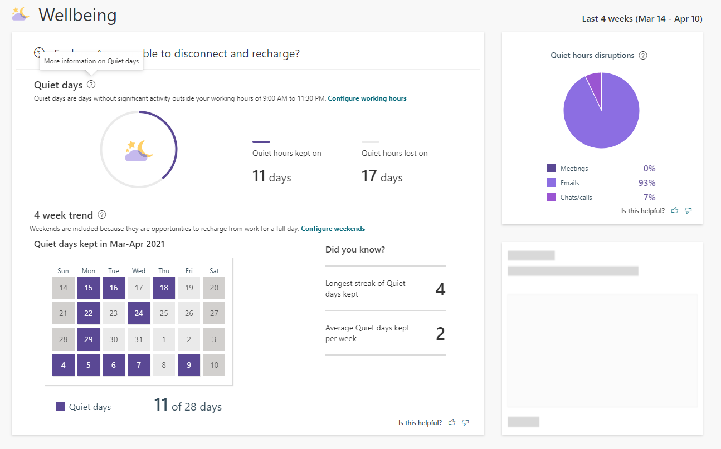
it.myanalytics.contoso.com/?v=wellbeing
Analytics

Slide 15
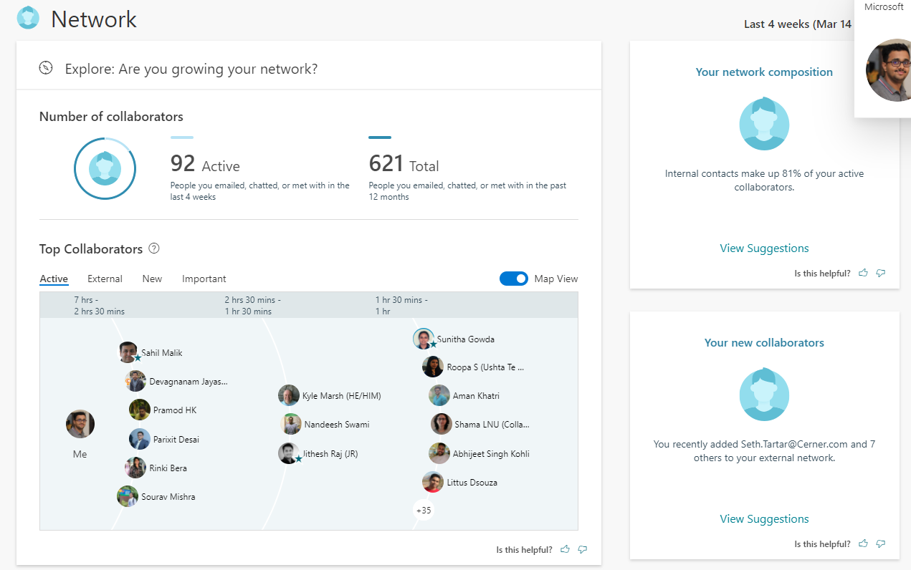
Analytics

Slide 16

Conversations
/channels
Groups
/groups
Files
/drive
Security
/security
Devices
/deviceManagement
User
/me
Events
/events
Tasks
/tasks
Mail
/messages

Slide 17
Find all the events in my Outlook calendar
GET https://graph.microsoft.com/v1.0/me
/events?$select=subject
me
Create a new folder in my OneDrive service
POST https://graph.microsoft.com/v1.0/me
/drive/root/children
me
Get me a list of all the conference rooms in my building
GET https://graph.microsoft.com/beta/me
/findRoomLists
me

Slide 18
files
Find me the OneDrive files that a user edited in Word last week
Schedule time for a meeting with a group on their Outlook calendar
calendar
task
group
Update a Planner task for a user based on their group membership
Start a new conversation thread for a group in Microsoft Teams
conversation

Slide 19
Popular data sets
Mail
Conversations
Tasks
Users
Files
Events

Slide 20
Activities
Attachments
Audits
Calendar
Categories
Charts
Classes
Contacts
Conversations
Cross-device experiences
Customer booking
Device configuration
Device management
Domains
Education
Events
Files
Financials
Groups
Identity
Lists
Mail
Messages
Notes
Notifications
Pages
Places
Plans
Reports
Schools
Search
Secure score
Security alerts
Sites
Social
Subscriptions
Tasks
Teams
Threat intelligence
Users
Workbooks
…and many, many more

Slide 21
Microsoft Graph powers experiences that are individually helpful and collectively powerful

Slide 22
Demo: Graph Explorer

Slide 23
Building your first Microsoft Graph-powered app

Slide 24
Microsoft 365 Platform
Extend Microsoft 365 experiences
Build your experience
Documents
Conversations
Portals
Timeline
Search
Web apps
Bots & agents
Device & native
Daemon apps
Workflow automation
Analytics apps
Microsoft Graph API
Microsoft 365
Users
Chats
Files
Devices
Mail
Alerts
Events
Security
Search
Events

Slide 25







Cross-platform support
.NET
Tier 1
Objective-C
Tier 2

Slide 26
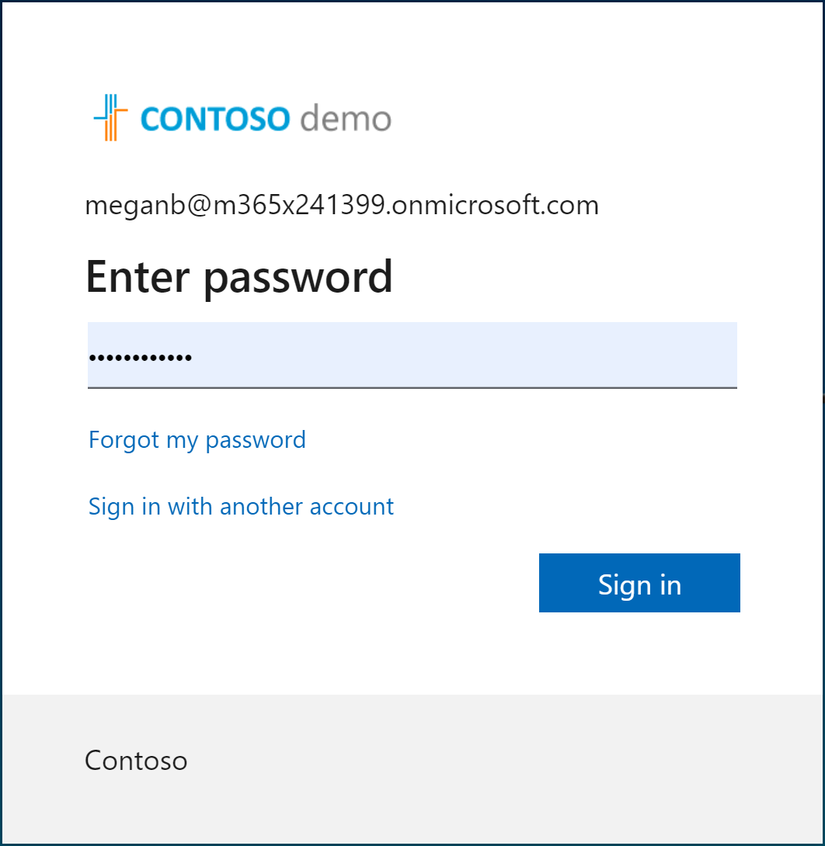
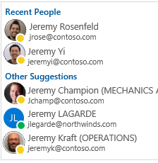
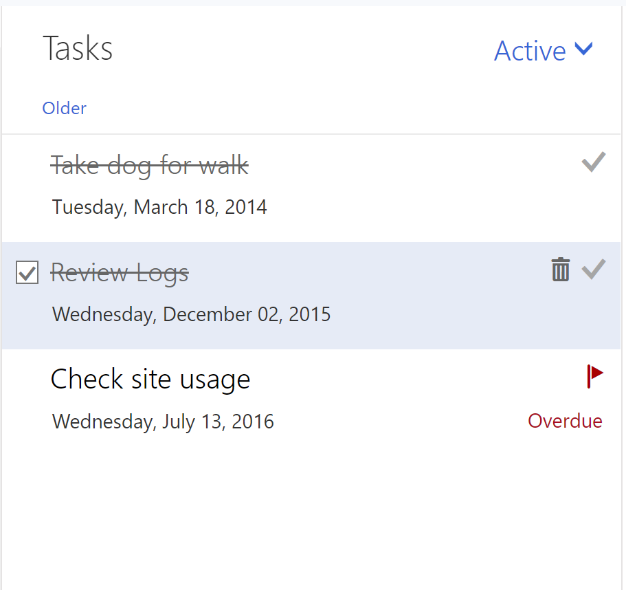
Microsoft Graph Toolkit
A collection of framework-agnostic web components powered by Microsoft Graph
login
people-picker
tasks

Slide 27
Demo: Microsoft Graph Toolkit

Slide 28
Demo: ASP.NET core application

Slide 29

5 tips and tricks to become a Graph coder
Know the 7 basic operations
Learn the 7 basic query parameters
Watch for server-side pagination
Investigate other query patterns (webhook+delta)
Used least privileged permissions

Slide 30
TIP 1 | Know the 7 basic operations
Intent | HTTP METHOD | Description | Example
List | GET | List collection | GET /users
Get | GET | Get member of the collection | GET /users/{id}
Create | POST/PUT | Create new item in the collection | POST /users/ PUT /me/activities/{id}
Update | PATCH/PUT | Update item | PATCH /users/{id} PUT /me/activities/{id}
Delete | DELETE | Delete item | DELETE /users/{id}
Invoke | POST | Invoke operations | POST /domains/{id}/verify
Batch | POST | Execute multiple requests | POST /$batch

Slide 31
POST/PATCH/PUT | no response required
If your code doesn’t need to get a response, then opt out
Don’t send unnecessary data over the wire
Tip
Use HTTP
Prefer return=minimal request header
Some services always return 204 No content for PATCH and PUT

Slide 32
TIP 2 | Learn the 7 basic query parameters
Value | Description | Example
$filter | Filters results (rows) | /users?$filter=startsWith(givenName,’J’)
$select | Filters properties (columns) | /users?$select=givenName,surname
$orderBy | Orders results | /users?$orderBy=displayName desc
$top | Sets the page size of results | /users?$top=10
$expand | Retrieves related resources | /groups?$expand=members
$count | Retrieves the total count of matching resources | /me/messages?$top=2&count=true
$search | Returns results based on search criteria. Currently supported on messages and person collections | /me/messages?$search=pizza

Slide 33
Querying data | Use projections
Choose the properties your app really needs and no more
Don’t send unnecessary data over the wire
Tip
Use $select
GET https://graph.microsoft.com/v1.0/users?
$select=givenName,mail

Slide 34
Querying data | Use filters
Choose the records your app really needs and no more
Don’t send unnecessary data over the wire
Tip
Use $filter
GET https://graph.microsoft.com/v1.0/users?
$filter=department eq ‘Sales’ & $select=givenName,mail

Slide 35
TIP 3 | Watch for server-side pagination
Graph uses server-side page size limits
When querying collections, Graph may return the results in many pages
Always expect an @odata.nextLink property in the response
Contains the URL to the next page

Slide 36
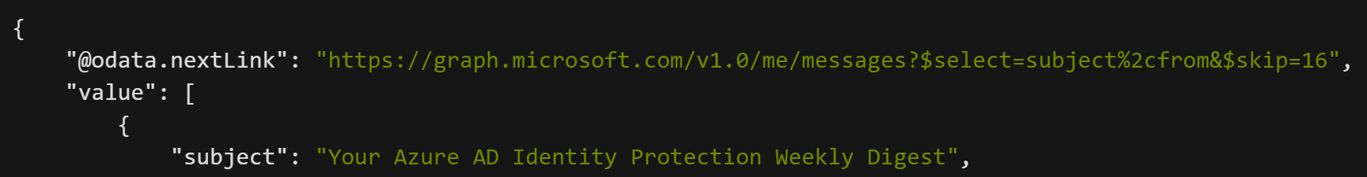
Request
Response
1.
Always handle the possibility that the responses are paged in nature
2.
Follow the @odata.nextLink to obtain the next page of results
3.
Final page will not contain an @odata.nextLink property
4.
Treat the entire URL as an opaque string

Slide 37
TIP 4 | Track changes | Webhooks + Delta query
Scenario
Same scenarios as before, but if you need to optimize further…
Tips
Use webhook notifications as the trigger to make delta query calls
Put notifications in a queue for later processing
Why
Difficult to figure out optimal polling interval

Slide 38
TIP 5 | Used least privileged permissions
Use least privilege! Only request permissions which are absolutely necessary, and only when you need them
Be thoughtful when configuring your app! This will directly affect end user and admin experiences, along with app adoption and security
When building a multi-tenant app, expect customers to have various application and consent controls in different states
Don’t use AppOnly for user interactive scenarios

Slide 39
5 tips and tricks to become a Graph coder
Know the 7 basic operations
Learn the 7 basic query parameters
Watch for server-side pagination
Investigate other query patterns (webhook+delta)
Used least privileged permissions

Slide 40
Continuous Access Evaluation
https://aka.ms/clientCAE

Slide 41
Great Session
https://www.youtube.com/watch?v=Mc1ilblJLJw
https://github.com/piotrci/Microsoft-Graph-Efficient-Operations
Time to get 100,000 users goes from 5 ½ minutes to 18 seconds
UserScenarios: getting all users in a tenant.
GroupScenarios: getting all groups with members.
LicenseManagementScenarios: assigning or removing product licences
DeviceScenarios: creating a report of all devices registered in the tenant.
DeltaQueryScenarios: an optimized way to initialize a delta query for large resource collections (e.g. users or groups)

Slide 42
Migrate from Azure AD Graph
https://docs.microsoft.com/en-us/graph/migrate-azure-ad-graph-planning-checklist
Step 1: Review the differences between the APIs
Step 2: Examine API use
Step 3: Review app details
Step 4: Deploy, test, and extend your app

Slide 43

Get started today
Office 365
Your tailored experiences or customizations
Windows 10
Enterprise Mobility + Security
https://graph.microsoft.com

Slide 44
Microsoft Graph Overview
For Labs and Exercises please refer to the below links -
Build ASP.NET Core MVC apps with Microsoft Graph - Microsoft Graph | Microsoft Docs
Build ASP.NET MVC web applications with the Microsoft Graph .NET SDK - Learn | Microsoft Docs

